Slide 1
Notes:
Black slide for post-presentation discussion.

Slide 3
Restoration of Fire Suppression Impacts in Wilderness
Resource Advisor Guidelines

Slide 4
Fire Suppression Effects
Notes:
But when fire suppression tactics are used, there is opportunity to minimize the impacts and lessen the need for rehab of the effects of suppression later.

Slide 5
Fire Management Objectives
Describe appropriate management response and minimum impact management tactics used to manage wildland fire.
Identify how appropriate management response and minimum impact management tactics can be selected to reduce resource damage and rehabilitation needs.
Describe rehabilitation of fire management actions.
BAER must follow a similar philosophy.

Slide 6
Fire Suppression Rehabilitation Practices
Fire line
Helispots
Dozer Lines
Camps
Water
sources

Slide 7
Fire Suppression Rehabilitation Practices
The objective is to mitigate or eliminate as much resource damage as possible to preserve natural conditions.
The standards applied can significantly affect the cost of a fire.

Slide 8
Fire Suppression Rehabilitation Practices
Helispots
- Location –try and utilize natural openings
Consider burning piles at later date.
Spike Camps
Cover latrine.
Pick up all litter and naturalize.
IC, Staging Areas and Drop Points
Rehab commensurate with resource values.

Slide 9
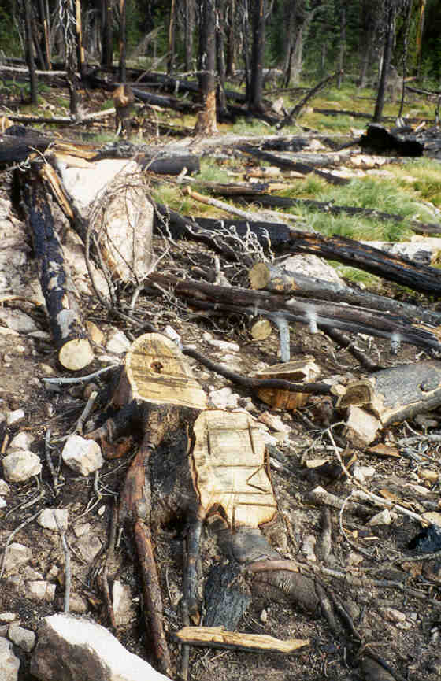
Fire Suppression Rehabilitation Practices
Stumps
Notes:
Scoring the stump to facilitate natural decomposition is good. The ideal is shown on the upper example – the cut run parallel to the slope ( in order to hold water, which speeds decomposition) and the cut stops short of the bark (rather than clear across the stump, which allows water to drain).
Carving the sawyers initials in the stump is to be avoided.

Slide 10
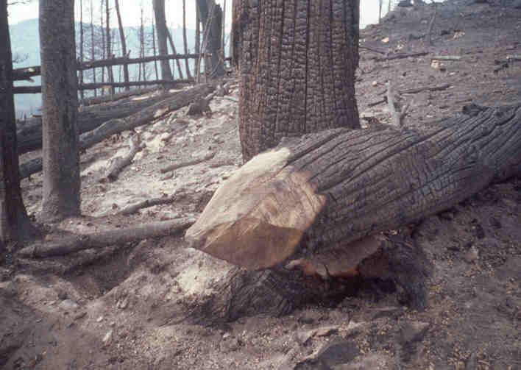
Fire Suppression Rehabilitation Practices
Cut ends
Notes:
A simple 45% cut on the underside of the cut end is visually less noticeable, but the more cut surfaces, the speedier decomposition is.

Slide 11
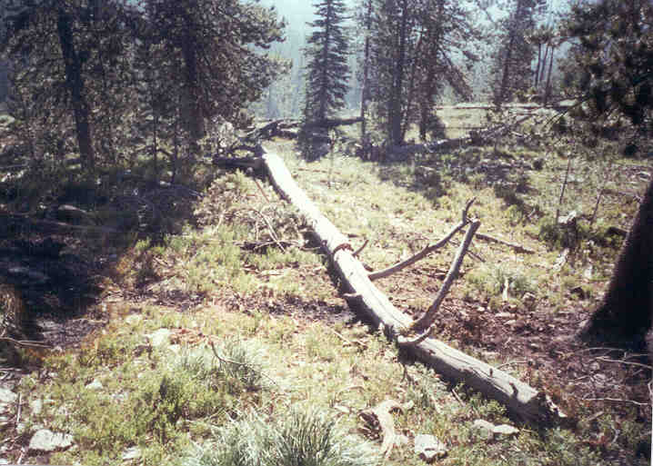
Fire Suppression Rehabilitation Practices
Log replacement
Notes:
An example of returning cut pieces to their original position.

Slide 12
Fire Line
Build line only where necessary
Utilize natural openings

Slide 13
Fire Line
During construction:
Flush cut stumps.
Limit bucking and limbing.
Use directional falling so trees will be crisscrossed in a naturally appearing arrangement.

Slide 14
Fire Line
Rehab of fire line:
Fill in berms and provide drainage, if necessary.
Scatter bone piles.
Slant cut large logs at 45-60 degrees on bottom side.
Naturalize.

Slide 15
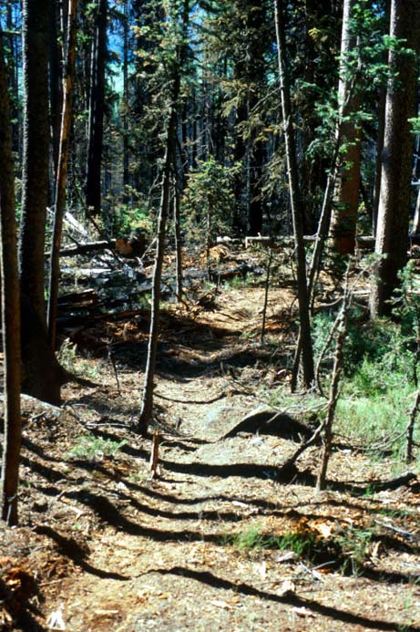
Notes:
The basic steps involved in rehabbing handline.

Slide 16
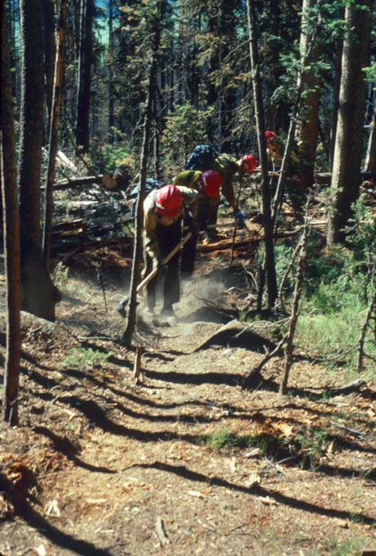
Notes:
Crews are pulling the berm back into the tread.

Slide 17
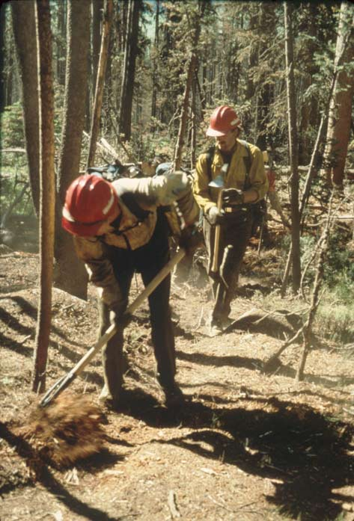

Slide 18
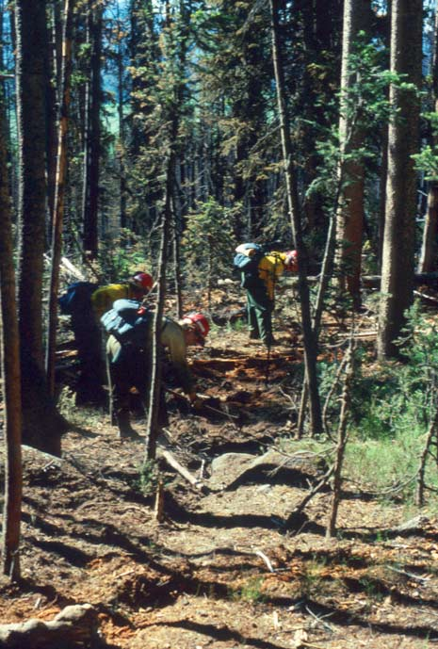
Notes:
They begin pulling woody debris across the line.

Slide 19
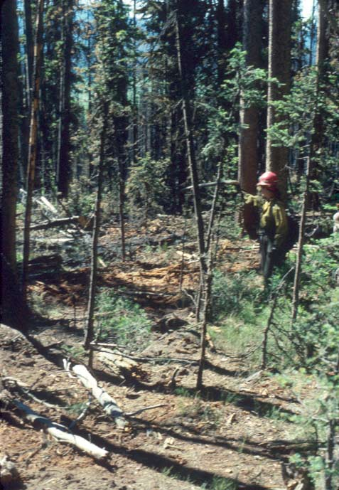

Slide 20
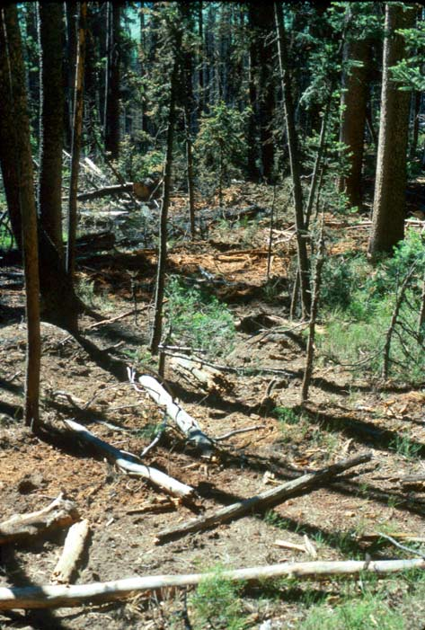
Notes:
And the finished product. Get creative!

Slide 21
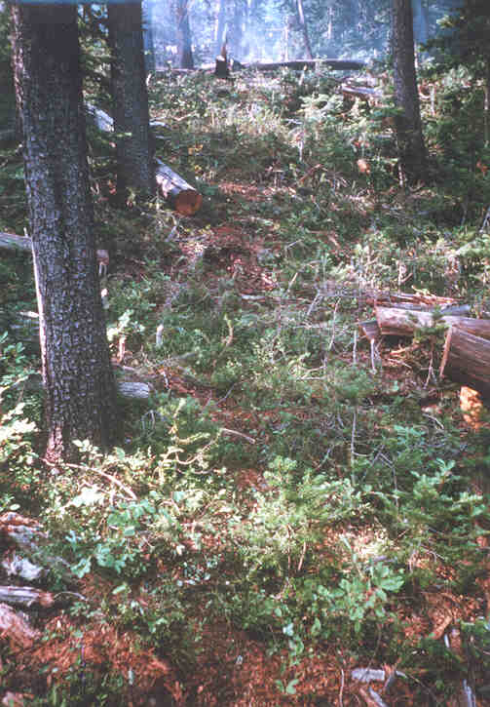
Fire Suppression Rehabilitation
Practices
Return to natural conditions
Notes:
Or this, depending on circumstances.

Slide 22
Water and Pumps
Water can help reduce impacts from line construction
Location of pumps and tanks can impact streams and riparian areas
Use of motorized equipment requires approval

Slide 23
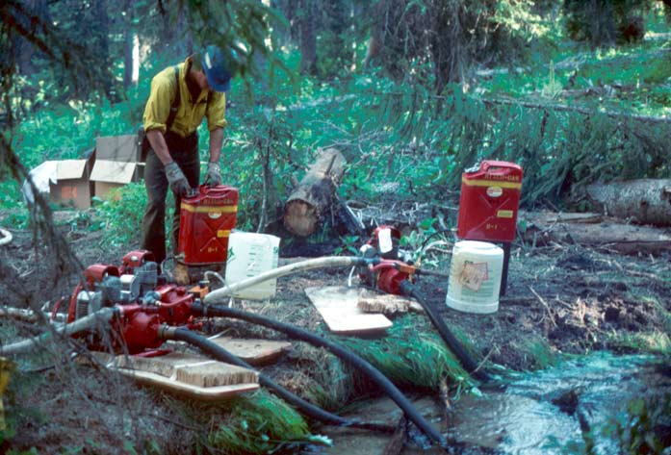
Water and Pumps
How Many Bad Things?
Notes:
Do you see any “watch out” situations?
Fuel can stacked next to creek…

Slide 24
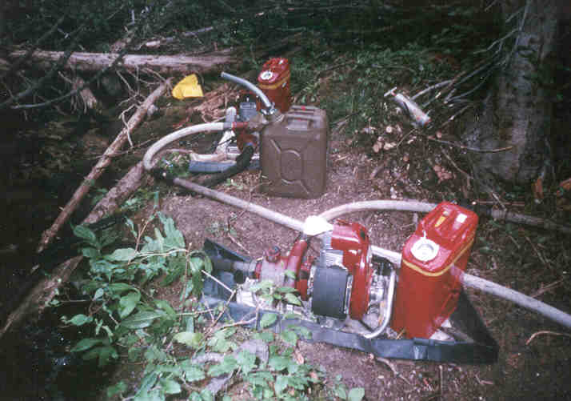
Water and Pumps
Notes:
Every pump and fuel can should have a liner and crews should know how to handle spills.
Water source locations need to consider fish habitat. Consult with resource advisor. Use appropriate filters.
Rehab to resemble natural conditions.

Slide 25
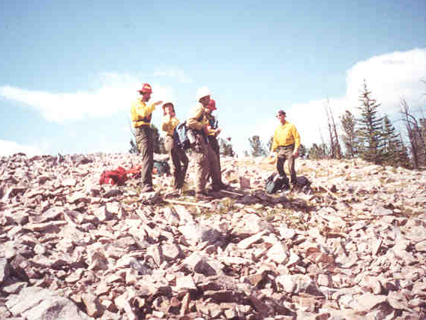
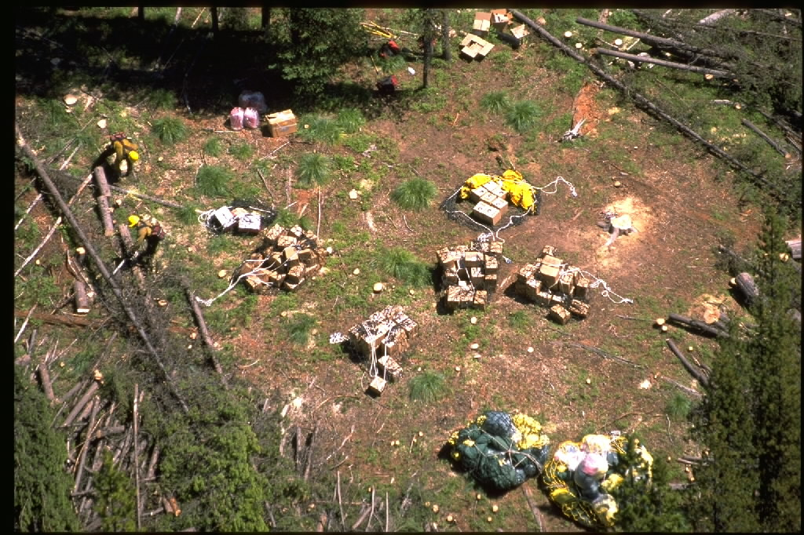
Helicopter Operations

Slide 26
Helicopter Operations
During planning consider the objectives.
If primarily as crew support, longline.
If primarily for crew shuttles:
Use natural openings.
Avoid construction in high use areas.
Are there others within reasonable walking distance?
Provide specific instruction for construction.

Slide 27
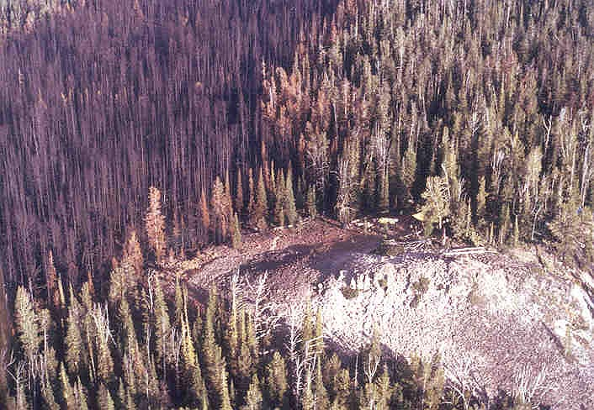
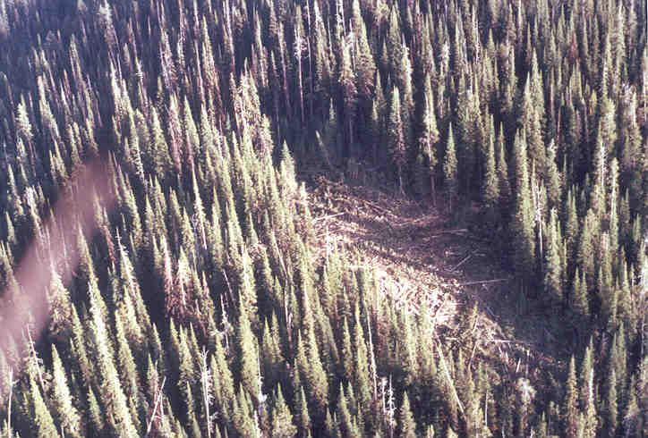
Helicopter Operations
This
vs.
This >
Notes:
This was a natural helispot on a fire in the Anaconda-Pintler Wilderness. Do you see any problems with it?
At top of fire….

Slide 28
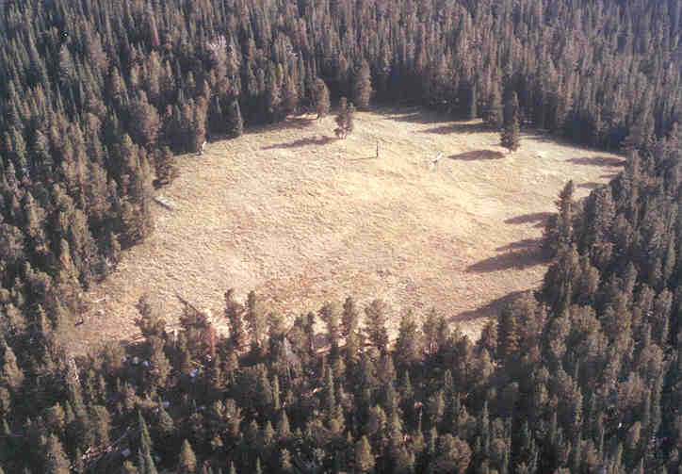
Spike Camp Management

Slide 29
FS Policy
FSM 2324.23 –Fire Management Activities.
Locate fire camps, helispots, and other temporary facilities or improvements outside of the wilderness boundary whenever feasible.
Rehabilitate disturbed areas within wilderness to as natural an appearance as possible.

Slide 30
Spike Camp Management
Use existing and impact resistant sites.
Avoid clearing and trenching – and NO bough beds.
Change location, if impacts are unacceptable.
Locate latrines 200’ from water and 8” deep.
Evaluate coyote camp impacts vs. travel.
Avoid wildlife (bear) attractants.

Slide 31
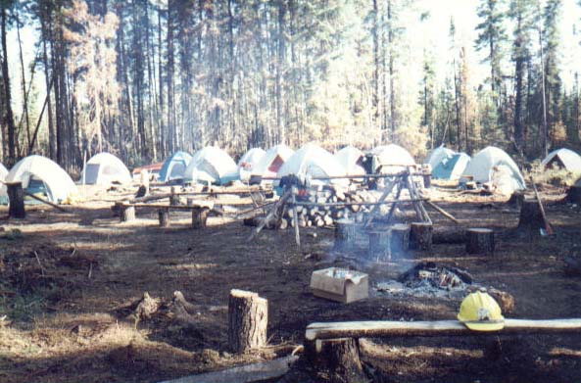

Slide 32
Spike Camp Management
Be involved in selecting sites.
Be there with the spike camp manager before the crews get there.
Define expectations for camp.
Notes:
Do you want to allow campfires? How much firewood is appropriate, and can it be chain sawed (if in wilderness)?

Slide 33
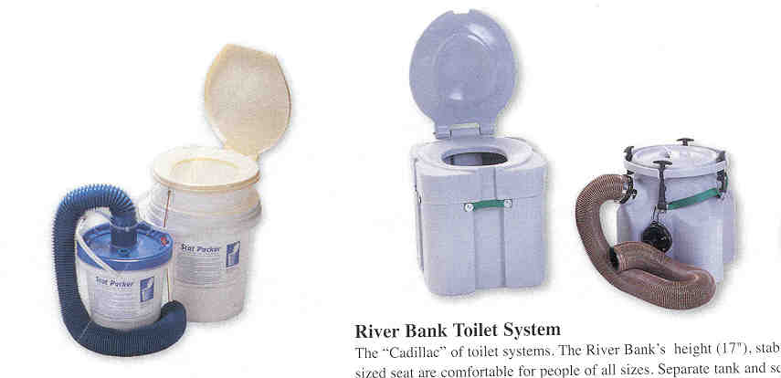
Human Waste
Notes:
Sanitation requirements can be met in different ways, depending on the number of people, length of stay, and site conditions.
In some situations (fragile, rocky, or high elevation sites with slow decomposition), the district may decide to buy “river-style” portapotties (or split the cost with the fire). The one on the right proved more stable in field conditions and removable containers can be swapped out of the main base. The keys to making this system work are:
Leather gloves for handling.
Adjacent hand washing facilities.
Privacy and signing for “in use”.
Signing for helicopter operations (hazardous material).
Make it easy and convenient!

Slide 34
Heritage Resource and Structure Protection
Notes:
Identify, determine minimum necessary action, and protect to avoid rehab. Later.

Slide 35
Snags and Limbing
Notes:
Safety first, of course, but…
Does the snag really need to come down or are there alternatives.
What will the wilderness visitors see when they return to the trails? The effects of the fire or the effects of the suppression?

Slide 36
Invasive species and noxious weeds
Notes:
Weeds and other non-native plants can enter the wilderness via vehicles in camp, pack stock, crews, helicopter nets, etc.
It’s another potential effect of suppression but this one can be very serious.

Slide 37
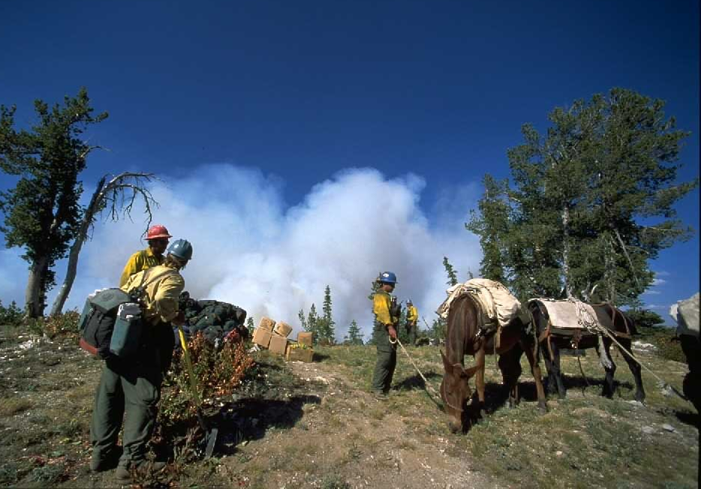
Invasive species and noxious weeds
Notes:
Some prevention techniques are easy like washing rigs as they arrive at the fire. Pack stock can be fed clean feed, groomed, and quarantined if necessary. Helicopter cargo nets can be inspected and if necessary cleaned. Crews can change clothes and wash tools. Other ideas?

Slide 38
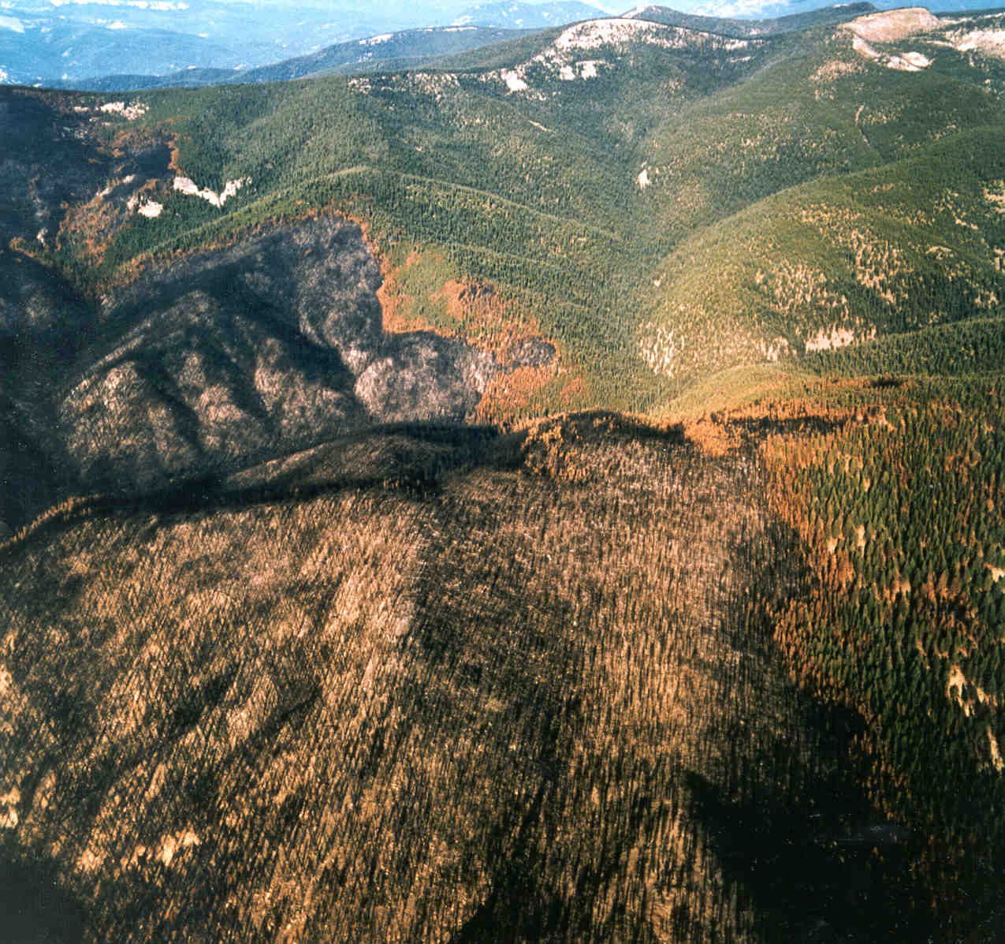
Wilderness, Fire, and BAER
Notes:
Closing statement…..

Slide 39
Notes:
Black slide for post-presentation discussion.

Slide 41
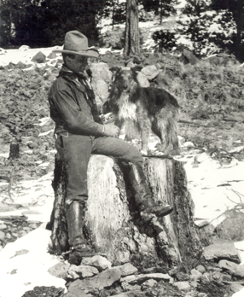
“A conservationist is one who is humbly aware that with each stroke he is writing his signature on the face of the land.”
Aldo Leopold, A Sand County Almanac, 1949

Slide 42
